Slide 1
Reinvéntate tu, no la rueda
Gestión de tareas con hangfire

Slide 2



Sergio Navarro Pino
I work for NEC, in its Cloud Computing Centre of Competence
Sometimes I write some tweets ( @snavarropino )
I also have a blog…Not yet forgotten…
http://serginet.blogspot.com

Slide 3
Background tasks
Background task are required in many developments…
think in an eCommerce solution that sells subscription services
Invoice generation at the end of every billing period
Monthly Reporting
Automatic subscription renewal
Regular Mailings
Send an email due to an action
Backgroung service provisioning

Slide 4
Background tasks
Sorts of background tasks
Fire & Forget
Send an email due to an action
Delayed
Automatic subscription renewal
Periodic & schedulled
Invoice generation at the end of very billing period
How to?

Slide 5

"Yo... he visto cosas que vosotros no creeríais: Atacar naves en llamas más allá de Orión.
He visto rayos C brillar en la oscuridad cerca de la Puerta de Tannhäuser.
Todos esos momentos se perderán... en el tiempo... como lágrimas en la lluvia. Es hora de morir"
- Roy Batty

Slide 6
Avaliable posibilities
Azure Scheduler ( https://azure.microsoft.com/en-us/services/scheduler/ )
Quartz.NET ( http://www.quartz-scheduler.net/ )
HangFire! ( http://hangfire.io/ )
Develop from scratch

Slide 7
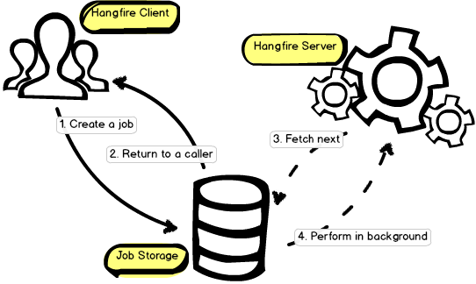
HANGFIRE Architecture
Fire & Forget Jobs
Delayed Jobs
Recurrent Jobs
All of them running in a background thread on same server or other one
ASP.NET Thread Pool safe!

Slide 8
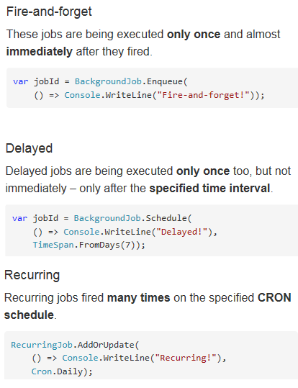

Launching tasks

Slide 9
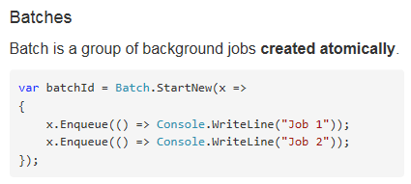
Launching BATCHES

Slide 10
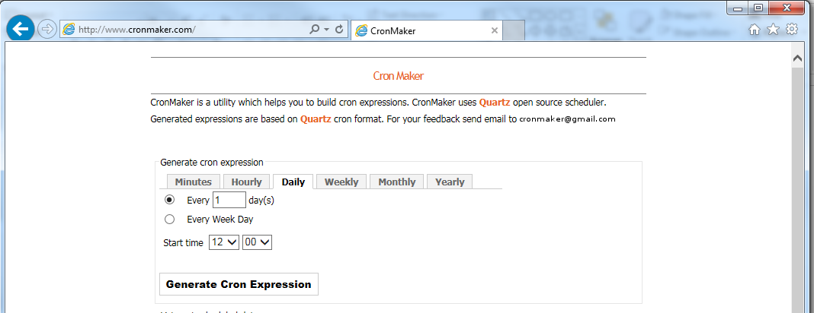
Cron expressions?

Slide 11
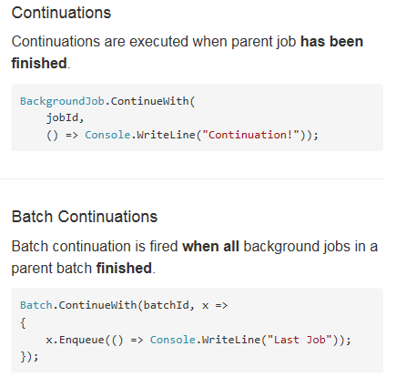
CONTINUING TASKS

Slide 12
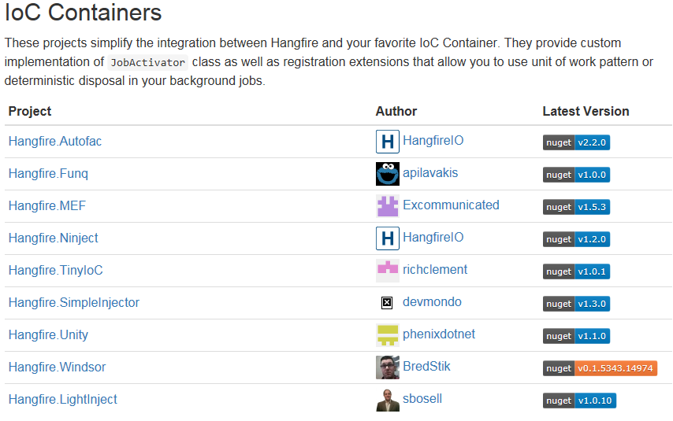
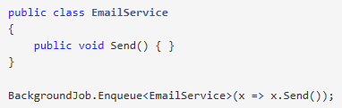
Method resolution
Statics are easy…
But instance methods are also supported
By default, the Activator.CreateInstace method is being used, so only classes with default constructors are supported by default.

Slide 13
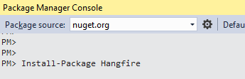
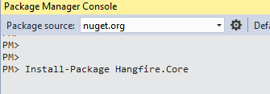
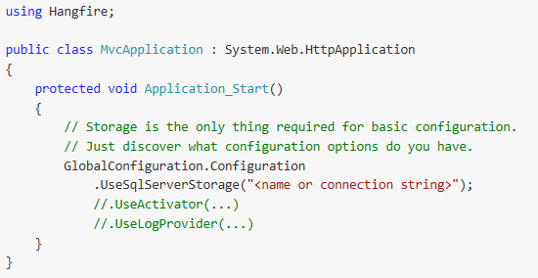
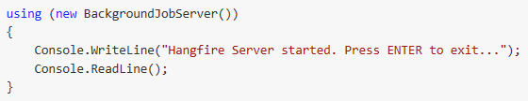
Hosting the hangfire server
IN ASP.NET
In a dedicated server (win srv, console app, etc…)

Slide 14


Slide 15
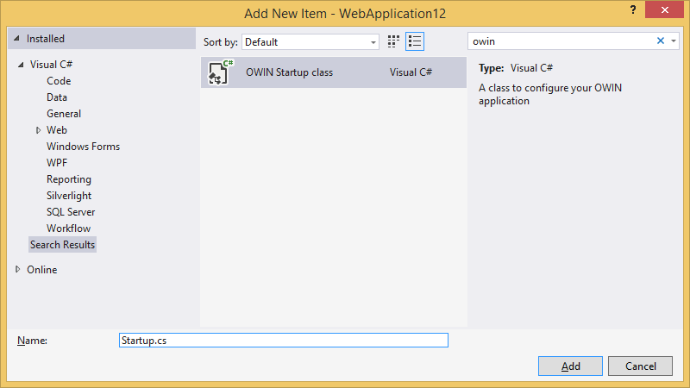
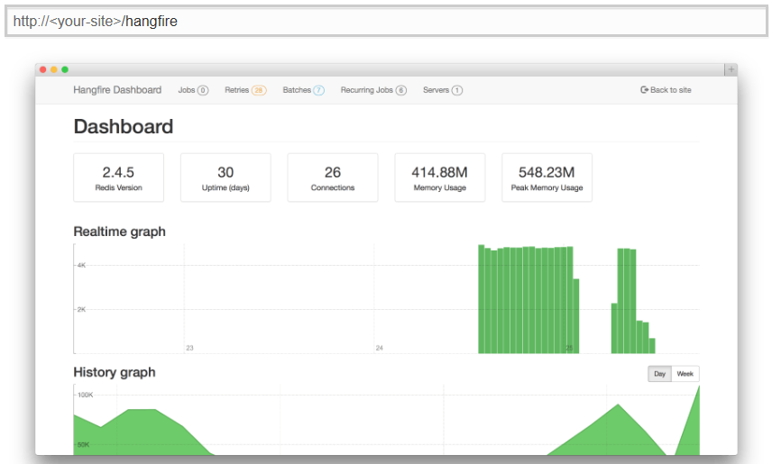
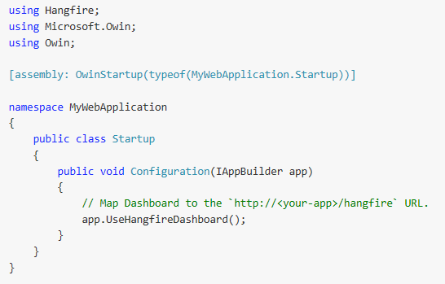
The dashboard

Slide 17
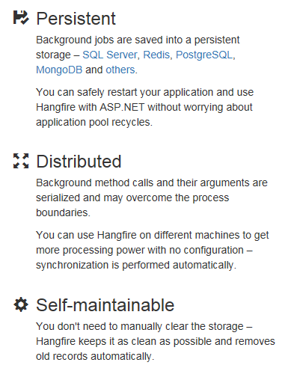
DIStributed task?

